Slide 1


Green Pace
Security Policy Presentation
Developer: Benjamin Strickland
Notes:
Hello, my name is Ben, and welcome to my Green Pace Security Policy presentation.

Slide 2

OVERVIEW: DEFENSE IN DEPTH
Security Audits
Attack Prevention / Mitigation
Defense in Depth
Notes:
This policy was developed to help Green Pace transition from a DevOps practice to DevSecOps. The policy acts as a guide to ensure that all products meet the required security features across the organization, improving Green Pace’s security. This will allow Green Pace to prepare for security audits as well as preventing attacks from malicious actors.
This policy defines several standards, which are informed by principles, so that we have a consistent methodology to uniformly define, implement, govern, and maintain every Green Pace product over time. The combination of standards and principles will create a series of defenses where, if one line of defense is overcome, another will be immediately encountered. This approach is known as Defense in depth.

Slide 3
THREATS MATRIX
Likely STD-008-CPP Ensure that container iterators and indices are within range | Priority STD-005-CPP: Do not access freed memory.
Low priority STD-001-CPP: Do not cast to an out-of-range enumeration value | Unlikely STD-006-CLG: Do not use assertions as part of the normal flow of code
Notes:
I chose four standards to highlight here, one for each category. The top-left one with the heading of ‘Likely’ is ensuring that container iterators and indices are within range. It’s easy to try to access a container using an index that is out of bounds.
The next standard is on the top-right under the heading ‘Priority’. Do not access freed memory is a good standard because of how easy pointers are to use in C++. It is likely that a developer might try to reuse a pointer that has gone out of scope, leading to undefined behavior.
The next standard, the one on the bottom-left, has a low priority, but it is still a good reminder to be careful when casting variables, especially when we are performing operations using these variables, it is likely that trying to cast to a smaller-capacity variable will cause an overflow.
The last standard, on the bottom-right, is Do not use assertions as part of the normal flow of code. It is unlikely, but still important for developers to understand that assertions might be turned off at some point to improve efficiency. If an assertion is being used to perform a necessary task, then that task will no longer be done, and could lead to serious instability.

Slide 4
10 PRINCIPLES
Validate Input Data
STD-001-CPP: Do not cast to an out-of-range enumeration value.
STD-002-CPP: Ensure that unsigned integer operations do not wrap.
STD-008-CPP: Ensure that container iterators and indices are within range.
Heed Compiler Warnings
Architect and Design for Security Policies
STD-003-CLG: Guarantee that storage for strings has sufficient space for character data and the null terminator.
STD-007-CPP: Handle all exceptions.
Keep it Simple
STD-006-CLG: Do not use assertions as part of the normal flow of code.
Default Deny
Adhere to the Principle of Least Privilege
STD-004-CPP: Prevent SQL injection.
Sanitize Data Sent to Other Systems
STD-001-CPP: Do not cast to an out-of-range enumeration value.
STD-002-CPP: Ensure that unsigned integer operations do not wrap.
STD-004-CPP: Prevent SQL injection.
STD-008-CPP: Ensure that container iterators and indices are within range.
Practice Defense in Depth
STD-002-CPP: Ensure that unsigned integer operations do not wrap.
STD-004-CPP: Prevent SQL Injection
STD-007-CPP: Handle all exceptions.
Use Effective Quality Assurance Techniques
STD-006-CLG: Do not use assertions as part of the normal flow of code.
Adopt a Secure Coding Standard
STD-005-CPP: Do not access freed memory.
STD-009-CPP: Always properly close file access when done. Do not allow a file to remain open after program execution.
STD-010-CPP: Do not reference uninitialized variables.
Notes:
This slide lists the ten principles and the standards that I mapped to them. Most principles have more than one corresponding standard. Two do not have corresponding standards. Those two are 2. Heed Compiler Warnings and 5. Default Deny. The former is indirectly upheld by all the standards because the compiler might be the first tool that offers a warning when something is not right. The latter is important, but it is somewhat superseded by 6. Adhere to the Principle of Least Privilege since these two principles have some overlap.

Slide 5
CODING STANDARDS
STD-004-CPP: Prevent SQL injection.
STD-009-CPP: Always properly close file access when done. Do not allow a file to remain open after program execution.
STD-010-CPP: Do not reference uninitialized variables.
STD-002-CPP: Ensure that unsigned integer operations do not wrap.
STD-006-CLG: Do not use assertions as part of the normal flow of code.
STD-007-CPP: Handle all exceptions.
STD-008-CPP: Ensure that container iterators and indices are within range.
STD-005-CPP: Do not access freed memory.
STD-003-CLG: Guarantee that storage for strings has sufficient space for character data and the null terminator.
STD-001-CPP: Do not cast to an out-of-range enumeration value.
Notes:
Here are the ten coding standards ranked in my order of significance.
The first standard is Prevent SQL Injection. I chose this as the highest rank because SQL injection is one of the more common methods for an unauthorized user to gain sensitive information from the server.
The second standard is Always Properly Close File Access when Done. This is in the second rank because files left open are vulnerable to tampering.
The third rank is Do Not Reference Uninitialized Variables. I chose this as the third rank because uninitialized variables could contain anything or be null. This is a serious vulnerability for program stability as well as security.
Number four is Ensure That Unsigned Integer Operations do not Wrap. The capacity of a variable should be verified prior to performing operations using it.
Number five is Do not use Assertions as part of the normal flow of code. Assertions are great for testing, but care must be taken that they don’t impact normal operation since at some point assertions may be turned off. If those assertions modified the code in some way, the program will become unstable.
Number six is Handle All Exceptions. This standard is sort of like a container for the following four standards since each of them are likely to throw an exception. If we are sure to handle all exceptions, then the following standards will also be accounted for.
Number seven is Ensure that container iterators and indices are within range. Out of bounds exceptions should catch this, but it is not a guarantee.
Number eight is Do Not Access Freed Memory. Accessing a deallocated pointer’s memory location is undefined behavior. Always make sure that a pointer is not destroyed until it is no longer needed, and do not reference it after it has been destroyed.
Number nine is Guarantee that storage for strings has sufficient space for character data and the null terminator. Trying to install data into a string that does not have sufficient space for all the characters and the null terminator can result in a buffer overflow.
Number ten is Do Not Cast to an Out-of-Range enumeration value. To avoid operating on unspecified values, the arithmetic value being cast must be within the range of values the enumeration can represent. When dynamically checking for out-of-range values, checking must be performed before the cast expression.

Slide 6
ENCRYPTION POLICIES
Encryption at rest: Data that is stored and not currently in use needs to be protected.
Encryption in flight: Data that has been requested from a server by a client needs to be protected while it is in transit.
Encryption in use: Data that is in use by a program still needs to be protected.
Notes:
Encryption at rest: Data that is stored and not currently in use needs to be protected. The best practice is to encrypt data at rest so that in the event of unauthorized access, the data is still secure. This is because the data is in a form that cannot be read without the key. This also follows along with the principles 5. Default Deny and 6. Adhere to the Principle of Least Privilege.
Encryption in flight: Data that has been requested from a server by a client needs to be protected while it is in transit. Since it is possible to perform man-in-the-middle attacks, and our reliance on the cloud is increasing, it is imperative that data is encrypted while it is being transferred between systems. This is supported by principles 7. Sanitize Data Sent to Other Systems and 8. Practice Defense in Depth.
Encryption in use: Data that is in use by a program still needs to be protected. There is a concern about the decrease in performance this can cause, but there are ways to counteract this, such as selective encryption of database fields, rows, and columns versus encrypting all data regardless of sensitivity. Data in use can be further protected by enforcing access rules such as role-based access control and multi-factor authentication, which can prevent unauthorized access to the data beyond encryption. This is supported by principles 5. Default Deny, 6. Adhere to the Principle of Least Privilege, and 8. Practice Defense in Depth.

Slide 7
TRIPLE-A POLICIES
Authentication: Authentication is the process of verifying that the user is who they claim to be.
Authorization: Authorization is the process of ensuring that an authenticated user is allowed to do the task they are trying to perform.
Accounting: Accounting is the process of monitoring traffic and keeping logs of all activity in the system.
Notes:
Authentication: Authentication is the process of verifying that the user is who they claim to be. This is primarily done by ensuring they know something that nobody else does, such as a password. However, a user can also be authenticated by what they have, such as a keycard. Since passwords can be guessed and keycards can be stolen, however, it is a good practice to use multi-factor authentication, which would require both the password and keycard in conjunction, increasing security against unauthenticated access.
Authorization: Authorization is the process of ensuring that an authenticated user is allowed to do the task they are trying to perform. One approach to this is role-based access control, where users are grouped by the roles they fulfill, and they are only given access to those actions necessary to complete their assigned tasks. According to the Principle of Least Privilege, a user or role should only be given enough privilege to complete their specific tasks, and no more. This prevents users from accidentally performing tasks they should not. It also limits the amount of access that users have to sensitive data, reducing the attack surface, adding another layer to the defense in depth approach.
Accounting: Even with multi-factor authentication and the Principle of Least Privilege, it is still possible for a bad actor to gain access to sensitive areas of the system. This is why accounting is so important. It is the process of monitoring traffic and keeping logs of all activity in the system. Without proper accounting processes in place, we might not know that an intrusion took place, and much less be able to do something about it. This is the importance of accounting. We need to know who gained access to which parts of the system and at what times in order to better understand the methods the intruder used to gain access. With all that information in hand, we will be able to design a defense against that type of intrusion, thereby adding more layers to our defense in depth strategy.

Slide 8
Unit Testing
STD-008-CPP: Ensure that container iterators and indices are within range.
Notes:
The coding standard I used to illustrate vulnerability testing is STD-008-CPP: Ensure that container iterators and indices are within range.

Slide 9
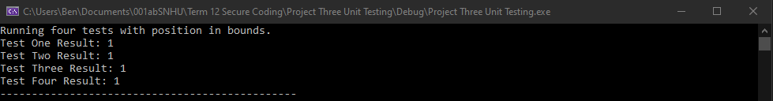
Testing with index in bounds.
I ran four tests with the index in bounds to prove that the tests are functional prior to testing with out-of-bounds indices.
Notes:
I ran four tests with the index in bounds to prove that the tests are functional prior to testing with out-of-bounds indices. Each test checks for the same thing; that the index is within the bounds of the array, but each test checks in a different way. Here you see each test returning the value in the second element, which is 1.

Slide 10
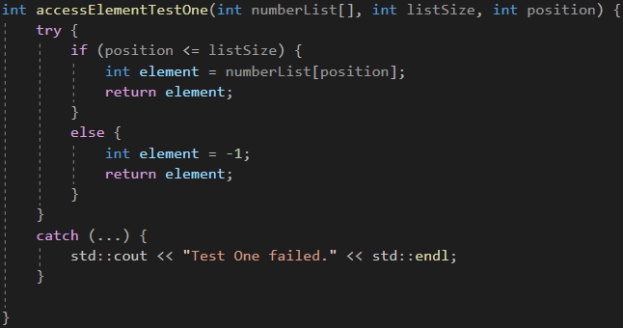
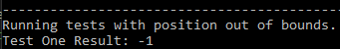
accessElementTestOne
The Test:
The Result:
Notes:
The first test uses a simple if statement to check if the position is less than or equal to the size of the array. If so, return the value of that element. If not, return -1, which is what we see returned.

Slide 11
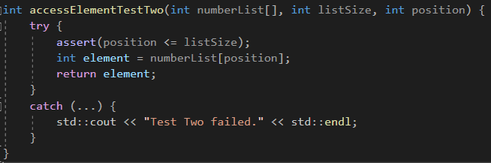
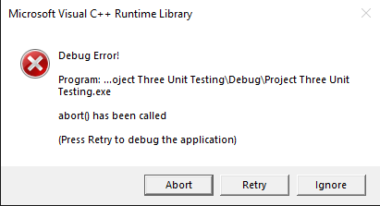
accessElementTestTwo
The Test:
The Result:
Notes:
This slide shows the second test, which uses an assert statement to ensure the position is less than or equal to the size of the array. As we can see by the result, the assertion failed, causing the program to abort.

Slide 12
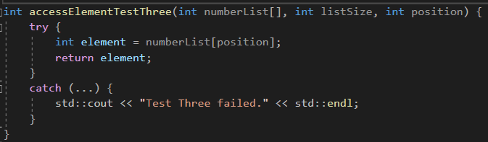
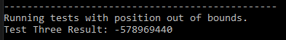
accessElementTestThree
The Test:
The Result:
Notes:
Test three does not have any checks in place. It is here to illustrate what happens when we neglect to test for boundaries when using containers. We can see by the result that Test Three accessed a piece of data that was unrelated to the running program; it just happened to be the data that was adjacent to the array’s 5th element.

Slide 13
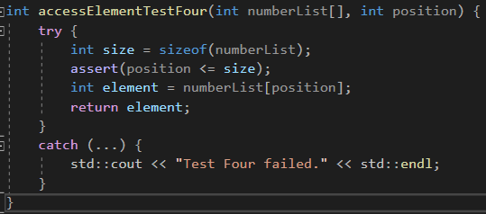
accessElementTestFour
The Test:
The Result:
Notes:
Test four also uses an assertion to ensure the index is within bounds. However, the previous tests conveniently had the array’s size passed in as one of the parameters. That still puts too much trust on incoming data. So, Test Four shows how we can compare the index with the actual size of the array, rather than trusting the parameter to be accurate. Test Four uses an assertion like Test Two did, which ends with the program aborting due to the assertion fail.

Slide 14

AUTOMATION SUMMARY
Notes:
The first place that automation should be included is the Design stage. Test-driven designs can benefit from automation because the test can run automatically and inform the design team where vulnerabilities might lie. This stage can also benefit from OWASP and other security testing services. The next stage is Build and it can also benefit from automation. At this stage we can implement static testing tools to identify vulnerabilities in open source and 3rd party repositories.
The verify and test stage can also benefit from automation. This stage includes vulnerability scanning and functional testing which can utilize automated tools to detect vulnerabilities. The following stage, Transition and health check, can likewise benefit from automation. Once the process for transition has been finalized, we can build tools to make this process automatic. If this automated process can also collect logs on issues encountered then we will more easily be able to automate the next step, Monitor and detect.
The Monitor and detect stage can benefit from automation by collecting logs on errors and build analytics to report on new and ongoing issues. This automation can also be utilized to feed into the next stage, where we respond to the issues identified. The response can likewise be automated to some extent. The best places for this kind of automation are blocking attacks and turning off services that come under attack.
Finally, the Maintain and stabilize stage can benefit from automation by having tools in place to return the system to a secure baseline in the event of an attack or compromise. These automated tools can also collect and format all the data collected and feed it into the first stage of pre-production where we Assess and plan. At this point, we can better assess the threat landscape and be better prepared for the following Design phase. With each iteration through this loop, our tools become more accurate, more secure, and more efficient.

Slide 15
TOOLS
CppCheck (static)
Unit Testing (dynamic)
Google Test
JUnit Testing
C++ Testing Framework
OWASP (Open Web Application Security Project)
Notes:
There is a wide variety of tools that can be utilized to help ensure that no vulnerabilities exist in a program. There are static testing tools that simply look for undefined behavior and dangerous coding constructs without executing the program and there are dynamic testing tools that run unit tests during runtime.
There is also OWASP which is an online community that produces freely available information on the field of web application security.

Slide 16
RISKS AND BENEFITS
The current problem is that Green Pace is using a DevOps pipeline. By transitioning into a DevSecOps pipeline through the use of this policy, we can rest assured that steps are being taken to mitigate any foreseen vulnerabilities.
The risks are the unforeseen vulnerabilities. We will need to have very strong measures in place across all three components of the Triple-A framework, but especially in accounting. We will need to be very quickly informed of unforeseen attacks and take steps to mitigate them.
One component that has not been mentioned thus far is a contingency plan. In the event that a catastrophic attack occurs, we will need to return to business as quickly as possible. We should have a handful of contingency plans in place.
Notes:
The current problem is that Green Pace is using a DevOps pipeline. By transitioning into a DevSecOps pipeline through the use of this policy, we can rest assured that steps are being taken to mitigate any foreseen vulnerabilities.
The risks are the unforeseen vulnerabilities. We will need to have very strong measures in place across all three components of the Triple-A framework, but especially in accounting. We will need to be very quickly informed of unforeseen attacks and take steps to mitigate them.
One component that has not been mentioned thus far is a contingency plan. In the event that a catastrophic attack occurs, we will need to return to business as quickly as possible. We should have a handful of contingency plans in place.

Slide 17
RECOMMENDATIONS
There are many more coding standards that could be included with this policy. It is recommended that a team audits the current standards on a continual basis, looking for vulnerabilities that are not currently being addressed, and for standards that no longer apply.
One gap in this security policy is the human element. Email phishing scams and other user-based vulnerabilities exist and should be accounted for. Users should be refreshed on best practices on a continual basis to ensure that these vulnerabilities are mitigated.
Another gap in this security policy is regarding the physical location of Green Pace and the systems it houses. There should be adequate security from fences and guard houses to key cards and video monitoring.
It is recommended that a policy similar to this one is created with the end user in mind.
Notes:
There are many more coding standards that could be included with this policy. It is recommended that a team audits the current standards on a continual basis, looking for vulnerabilities that are not currently being addressed, and for standards that no longer apply.
One gap in this security policy is the human element. Email phishing scams and other user-based vulnerabilities exist and should be accounted for. Users should be refreshed on best practices on a continual basis to ensure that these vulnerabilities are mitigated.
Another gap in this security policy is regarding the physical location of Green Pace and the systems it houses. There should be adequate security from fences and guard houses to key cards and video monitoring.
It is recommended that a policy similar to this one is created with the end user in mind.

Slide 18
CONCLUSIONS
There are two more principles that should be implemented, and they should be accompanied by a host of standards that support them.
The first new principle is “Define security requirements”. This means including security requirements into every level and phase of the SDLC.
The second new principle is “Model threats”. This means anticipating what form future threats will take on. The team should decompose their current applications to identify and categorize the threats that might appear in the future.
Threat modeling might have prevented the SolarWinds attack. If SolarWinds had taken steps to consider the types of attack that might occur, they may have seen the attack coming, or at least noticed the intrusion sooner (Temple-Raston, 2021).
Notes:
There are two more principles that should be implemented, and they should be accompanied by a host of standards that support them.
The first new principle is “Define security requirements”. This means including security requirements into every level and phase of the SDLC.
The second new principle is “Model threats”. This means anticipating what form future threats will take on. The team should decompose their current applications to identify and categorize the threats that might appear in the future.
Threat modeling might have prevented the SolarWinds attack. If SolarWinds had taken steps to consider the types of attack that might occur, they may have seen the attack coming, or at least noticed the intrusion sooner (Temple-Raston, 2021).

Slide 19
REFERENCES
Temple Raston, Dina. (April 16, 2021). A ‘worst nightmare’ cyberattack: The untold story of the SolarWinds hack. NPR.org. https://www.npr.org/2021/04/16/985439655/a-worst-nightmare-cyberattack-the-untold-story-of-the-solarwinds-hack

